Slide 1
Cylon.JS : The IoT Framework
Saurabh kirtani
@saurabhkirtani
Notes:
JSFoo India – 16 Sep, 2016

Slide 2

Dominating everywhere

Slide 3
JavaScript and IoT

Slide 4
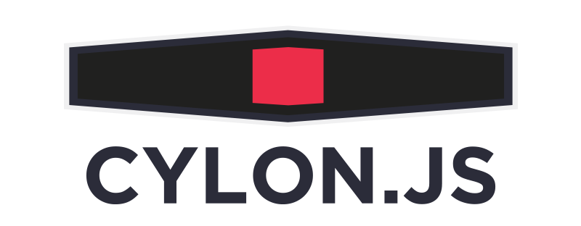

Slide 5
JavaScript framework for robotics and physical computing using Node.js

Slide 6
Multiple, different hardware devices

Slide 7
Makes programming devices as easy as web dev

Slide 8
MCP
The Master Control Program is responsible for coordinating everything else inside Cylon. It manages adding new Robots, and starting/stopping both Robots and the API.

Slide 9
Robots
A Cylon robot is a collection of devices and connections, with the necessary glue to allow them to coordinate together.

Slide 10
Devices and Connections
An abstraction layer over drivers and adaptors, respectively.

Slide 11
Drivers and Adaptors
Adaptors are in charge of connecting to platforms, no matter the medium. For example, the cylon-sphero
The Adaptor classes ensure that the Drivers are able to directly communicate with the connected platform.
Drivers, meanwhile, are used to issue commands and handle events for platforms.

Slide 12
Example:
A Servo driver knows all the necessary commands to tell a Servo to turn to a certain angle. The Driver has no knowledge of how to connect to the Servo, it trusts the Adaptor to do that

Slide 13
Robot
Connections
Devices
Adapters
Drivers
Integrations
Events
Serial/Socket to serial
Hardware

Slide 14
Example: Run the same code to turn on a LED on different micro controllers

Slide 15
Code samples

Slide 16
Interacting remotely

Slide 17
IoT Hub

Slide 18
Demos
Blinky – Arduino
Button – Pi – real time update on Power BI
Servo – Pi - control from cloud (Azure)

Slide 19
Thank you. ☺
Saurabh Kirtani
@saurabhkirtani

Slide 20
Cylon | Johnny5
Also supports devices like drones/HMI in addition to low level board interfaces | Board interfaces support
Full framework with design patterns | Set of libraries for gpio/i2c/SPI interfaces
Declarative syntax | Imperative

